Slide 1
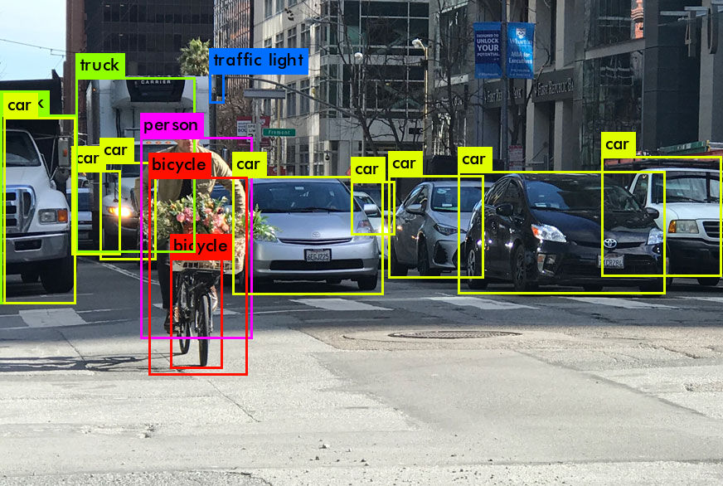
License Plate Detection Using Yolo_v3 Darknet
-Nitin Kumar

Slide 2
Objective
In this project, we are trying to use yolo_v3 object detector to detect license plate from image, video and webcam feed.
Our model will be trained on two classes Traffic signs and Vehicle registration plate.
The model should be able to:
recognize license plates from the input.
Save the license plate cropped image
Pre-process image
Read the License plate registration number from the processed image

Slide 3
Resources
Darknet Repo(https://github.com/AlexeyAB)
Yolo weights and Model(https://pjreddie.com/darknet/yolo/)
Visual Studio 2016-2019
Windows SDK
Nvidia Drivers
Cuda Toolkit+cudNN
OpenCV
OIDv4_Toolkit(https://github.com/EscVM/OIDv4_ToolKit)
Jupyter Notebook
Google Collab
Helper Functions

Slide 4
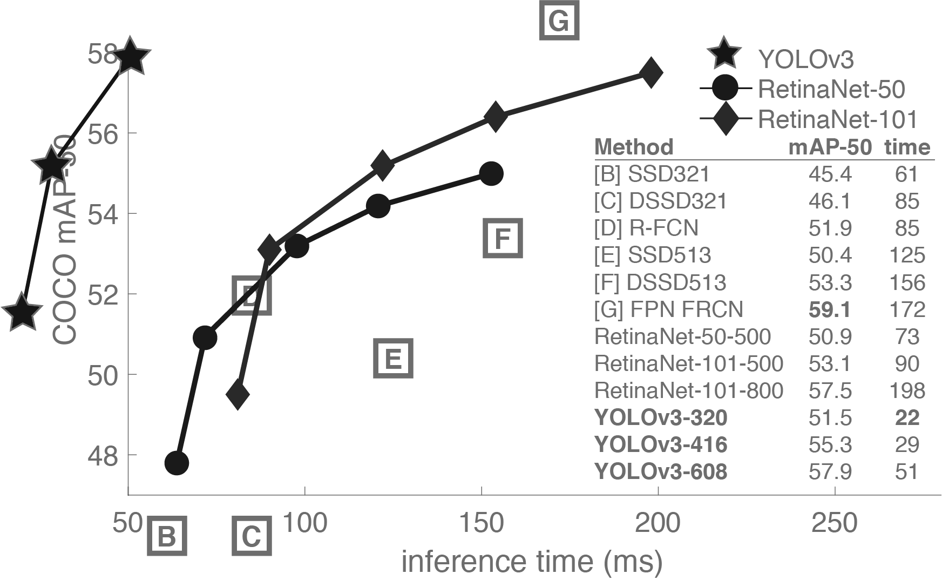
What is Yolo?
Yolo stands for You Only Look Once.
Yolo is a state of the art real-time object detection system.
Yolo is extremely fast and accurate.
Yolo can be configured for speed or accuracy by changing the size of the model, no retraining required.
Yolo is known for its speed and accuracy as compared to its competition.
One drawback of Yolo is that it struggles to detect multiple small objects clustered together.

Slide 5
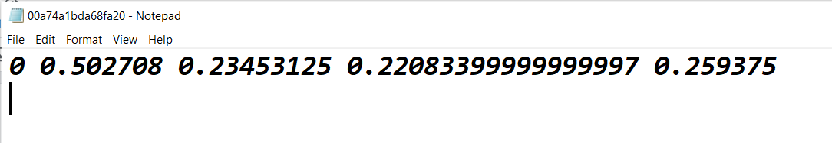
Bounding Box
A bounding-box is an imaginary rectangle that serves as a point of reference for object detection and creates a collision box for that object.
In Yolo the bounding box information is stored as (.txt) file, these files are also called label files.
The first value is the class label and the remaining are the x_min,y_min, width and height.

Slide 6
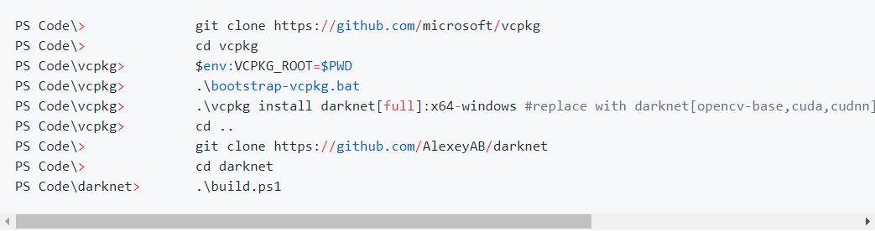
Clone,Build & Test Darknet
Clone GitHub Repo: https://github.com/AlexeyAB
Build Darknet using Windows Powershell or CMake
Test for Darknet Usage

Slide 7
Download Images using OIDv4_Toolkit
OIDv4_Toolkit is an image database for quick retrieval of images.
Images are available for Vanilla Models, Object Detection and Image Segmentation.
Images can be downloaded for train+validation
Steps for using OIDv4_Toolkit
Clone GitHub Repo: https://github.com/EscVM/OIDv4_ToolKit
Install requirements using requirements.txt
Test main.py file
Download Images using command python main.py downloader --classes Traffic_sign Vehicle_registration_plate --type_csv train+validation --limit 500
Here we are downloading 500 Images belonging to two classes for train+validation.

Slide 8
Yolo_v3 Training Files
There are four training Files we need to configure for the darknet model to start training.
Obj.data
Contains information like no.of class, location for train.txt, valid.txt, obj.names and backup.
Obj.names
Contains names for all the classes in the problem.
Train.txt
Location for all the training images
Valid.txt(same as train.txt)
Location for all the validation images

Slide 9
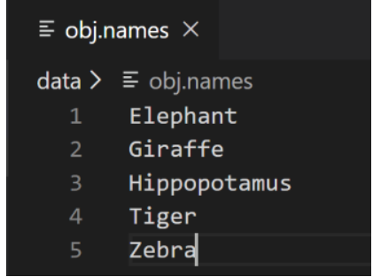
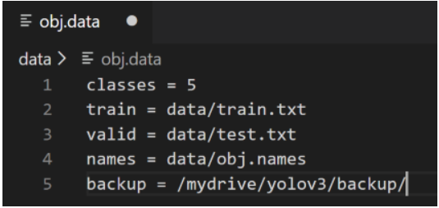
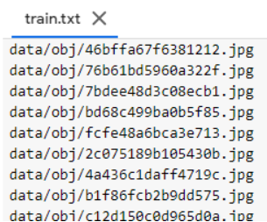

Slide 10
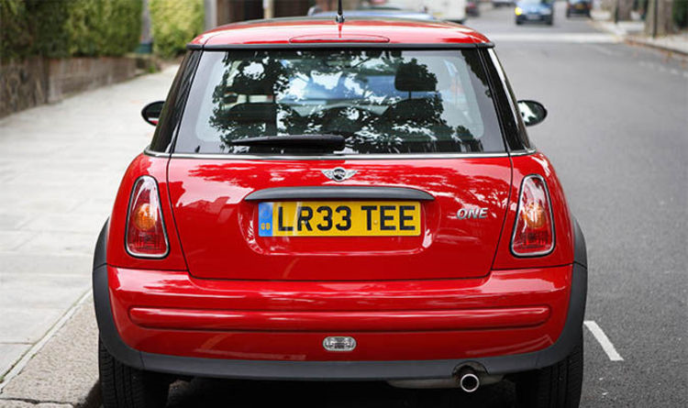
Configure and Train Model
Changes in yolo_v3.cfg for training
Set batch=64 & subdivision=16
Max Batches=2000*no_of_classes
Step Size= 0.80*Max Batches,0.90*Max Batches
Change values for the three Yolo Output layers
Change no. of classes
Filters= (no.of classes+5)*3
Model is ready for training.
Changes in yolo_v3.cfg for testing
Set batch=1 & subdivisions=1
Model is ready for testing on new images.
Let’s test the model on new images.
Test Image

Slide 11
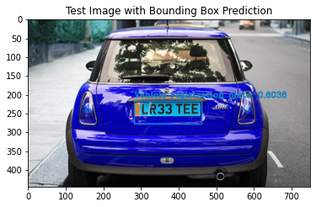
Test Custom Model

Slide 12

Save Object of Interest from Test Images
As the custom model was successful in detecting a vehicle registration plate from a test image.
We are going to write a small function which saves all the detected objects of interest to a new file.
We will then use the cropped image as input and feed it to pytesseract to get the text from a cropped image.
Object of interest cropped from the test image

Slide 13
Read License Plate using Tesseract
Installing pytesseract
Pillow: pip install Pillow
Tesseract-OCR: sudo apt install tesseract-ocr
Pytesseract: pip install pytesseract
We are are going to use image_to_string method call to extract text from image.
Tesseract-OCR is not 100% accurate, most of the times it mismatches the output, but since it is an open source library we are going to use pytesseract.

Slide 14
Repo Structure
nogifeet/
Vehicle-
License-
Plate-
Training Files
Coco.names, obj.data, train.txt, valid.txt, yolo_v3.cfg
crop
Cropped images
images
Test images
License Plate Detection.ipybp
convert.py
Convert annotations
train_darknet.py
Train darknet

Slide 15
Sources
https://pjreddie.com/darknet/yolo/
https://medium.com/swlh/how-to-make-the-perfect-readme-md-on-github-92ed5771c061
https://www.datacamp.com/community/tutorials/object-detection-guide
https://github.com/theAIGuysCode

Slide 16
THANK YOU

